Slide 1
Issues

Slide 2
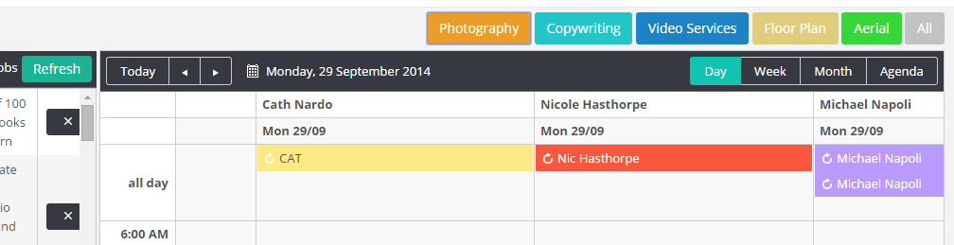
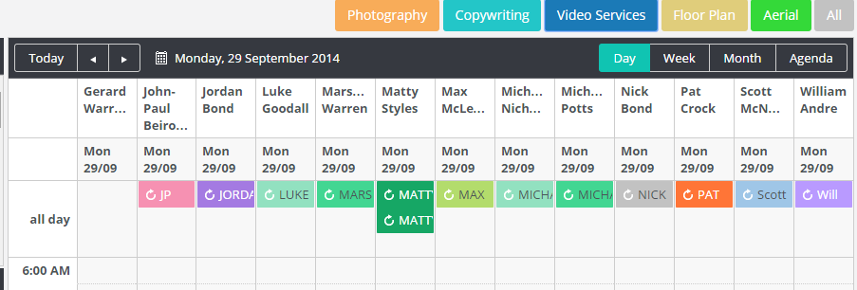
1. When click Photography, the width of calendars is too wide. It should be similar to when the user clicks Video Services.
Photography
Video Services

Slide 3
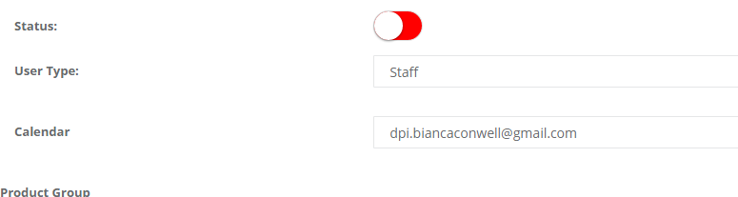

Can we add this colour picker to the User definition so a user can define the default colour. This is so user can mange default calendar colour for user.
This is the change request : Not started

Slide 4
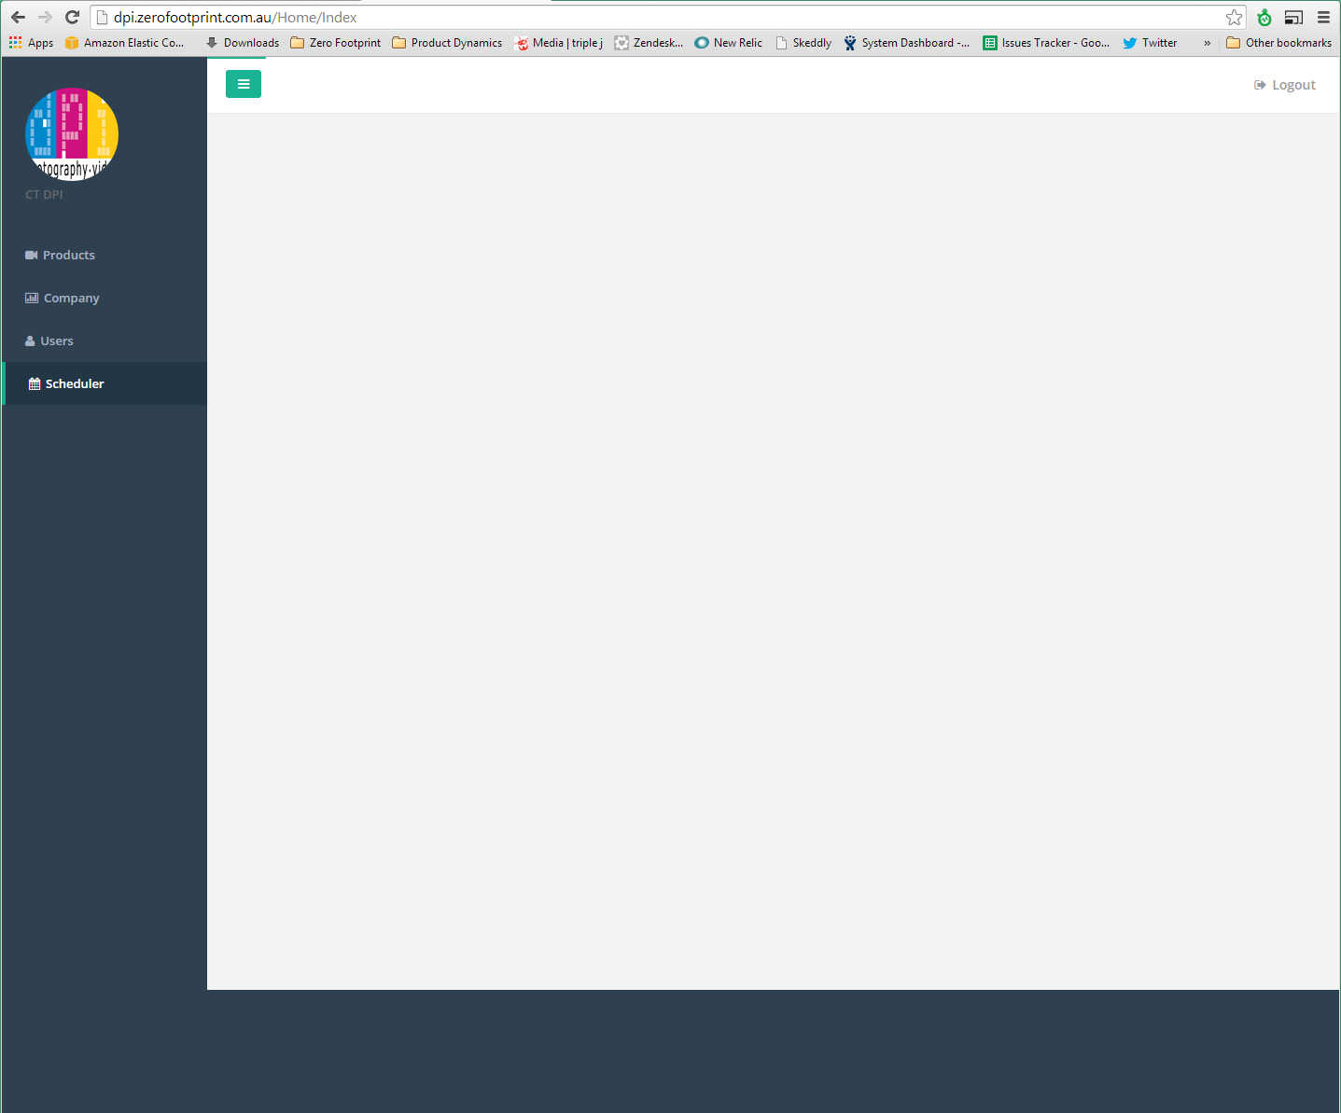
On page load, all controls should be initialised and loaded prior to loading the calendar data.
Load Sequence.
Load Page
Controls
Unscheduled Jobs
Default calendar entries.
This is a big change related to scheduler and it will require some research. Once we will done with all changes we can concentrate on this issue.

Slide 5
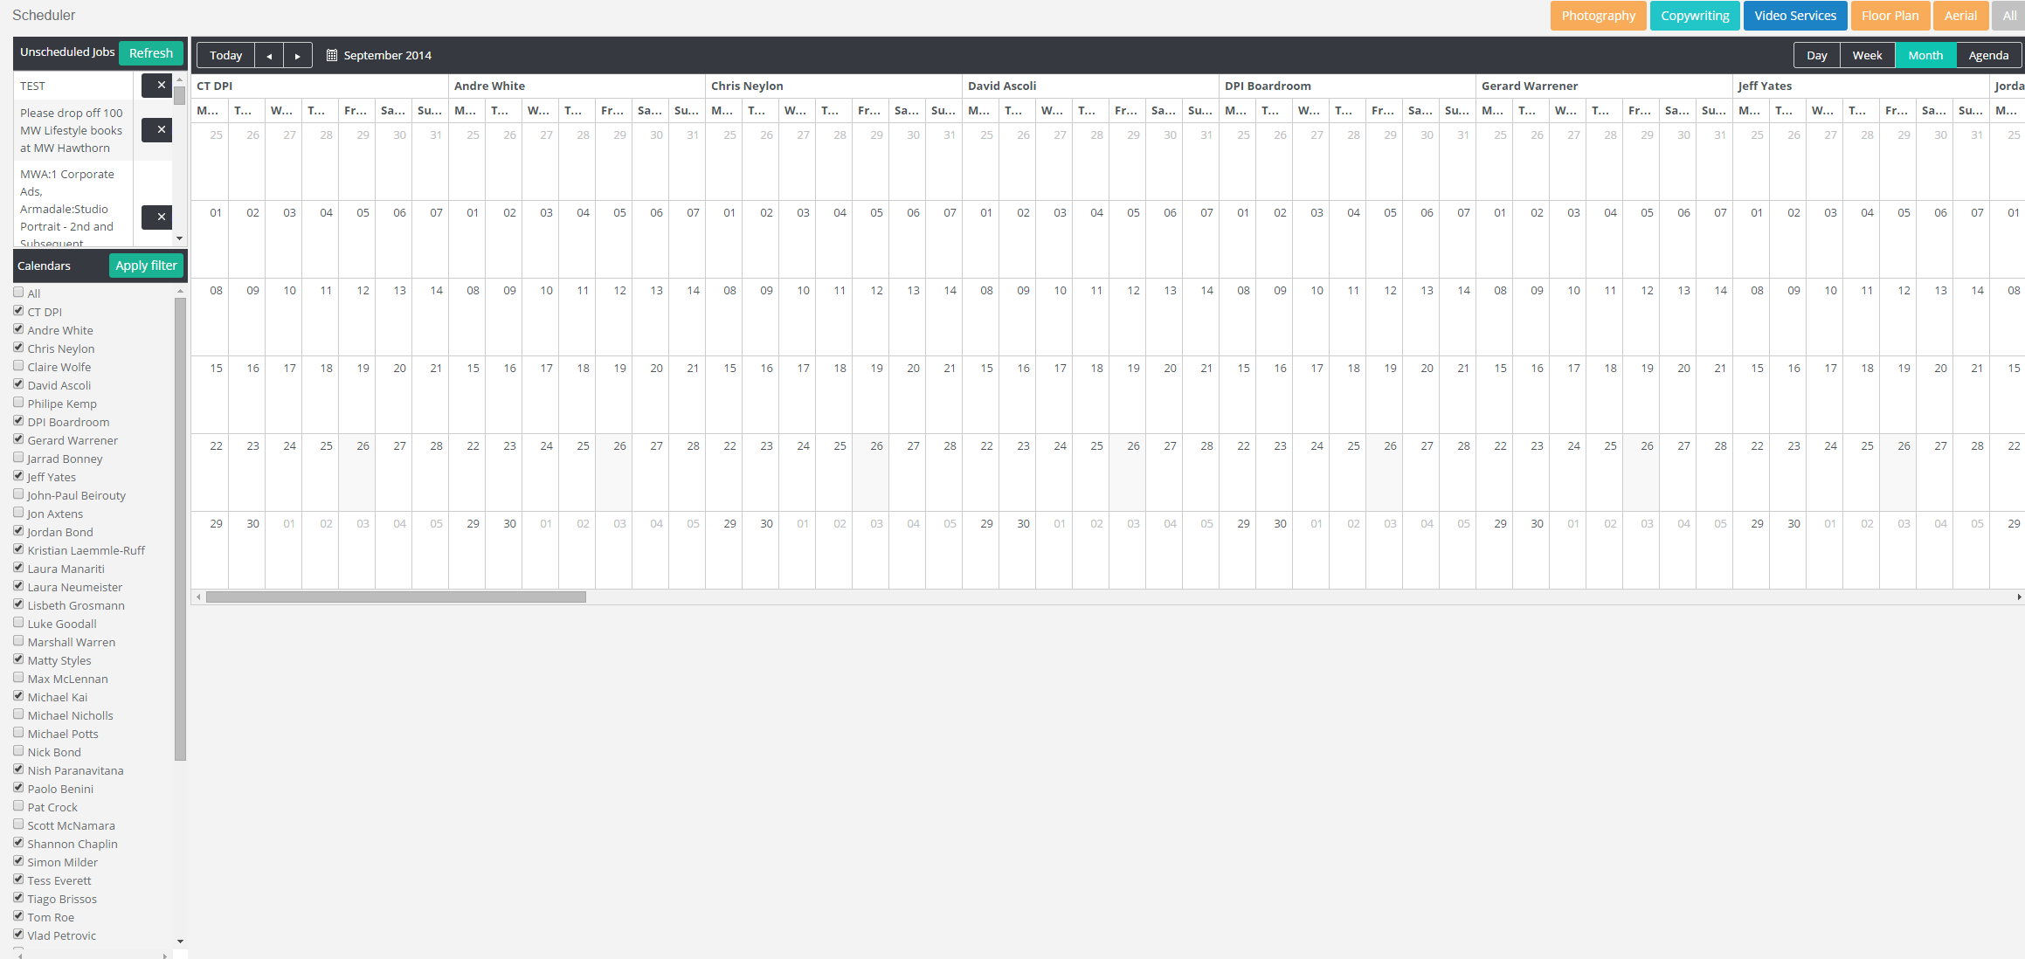
Is it possible to use more of the screen on Month view.
This is default Kendo scheduler behaviour, for this we need to contact Kendo support team.

Slide 6

If pressing Week/Month views and potentially a lot of calendars, it takes awhile to show its loading.. Again, can we:
Initialise Controls
Load Calendars
Load Calendar Entries.
This is default Kendo scheduler behaviour for this issue we need to contact Kendo support team.

Slide 7
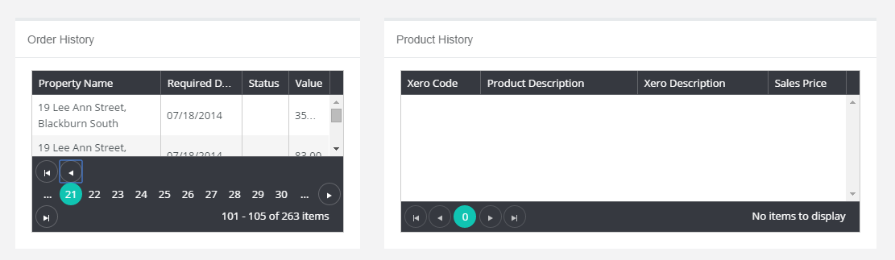
This Order History Grid Side by Size is not workable. Put Order History on Top of Product History rather than Side by Side.

Slide 8
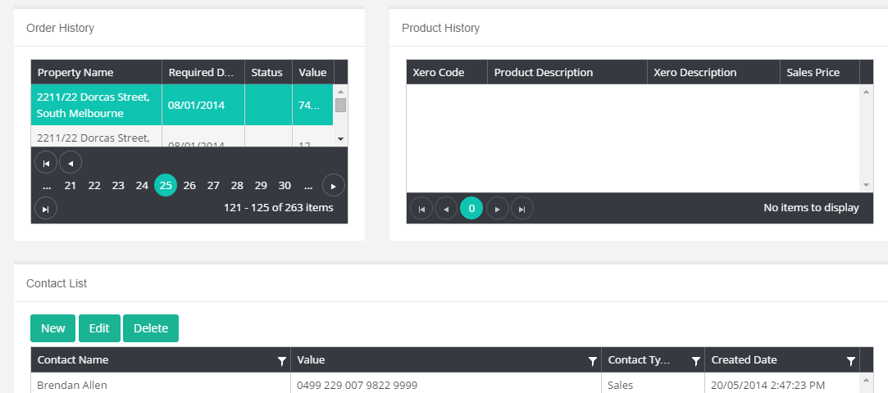
When clicking a specific order, it should constrain: 1. Product History module for only those products in the selected order. 2. Contact List, to only those contacts for the specific order.

Slide 9
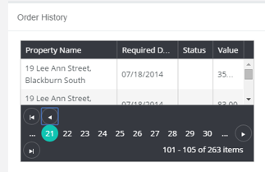
Add field Order.Order Id to this Order History list.

Slide 10
Change Requests

Slide 11

Can I have an estimate (CR) for these buttons to be dynamically derived from the database in terms of colour/label.
Not started

Slide 12
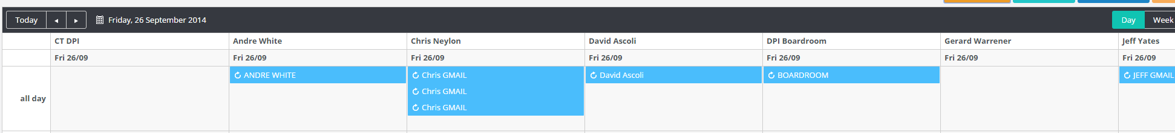
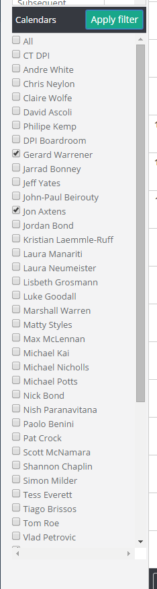
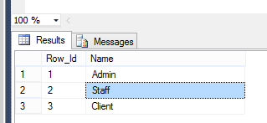
Please provide an estimate on the following (CR). 1. The client has Full-time (F), Part-time (PT) and Freelance (F) staff. They want to be able to order the calendars of Fulltime staff above those of Part-time and Freelancers. Order should side calendar list and top calendar names.
Add a two new fields on UserTypes table called
Type Varchar(100)
Order Int
It would include Full-time, Part-Time, Freelance in Type drop
Down.
Full Time ; Order = 1
Part Time; Order = 2
FreeLance; Order =3
the Order field will be used in the select of calendars to
Order from Min to Max.
In addition add a new field on User table and Manage User form
Called Rating. This would be a int value of 1 to 10 and represent the users ability to take on work.
10 being the best, 1 being the least work they can take on.
Order
Cal List
Select statement and order for calendars
would be
Select * from User U
Inner join CalendarUser CU
Inner join UserType
Order by UserType.Order Asc, User.Rating Desc,
U.FirstName Asc
Not started
Rating Slider

